Slide 1





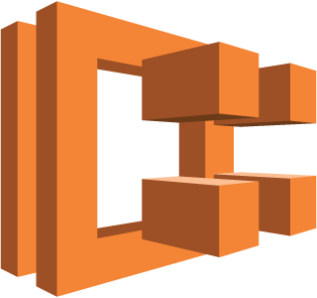

Internet gateway
Public subnet
Public subnet
NAT gateway
Studio Instance
NAT gateway
Application Load Balancer
ECS Cluster
ECS Host
ECS Host
AutoScaling Group
ECS Host
ECS Host
CloudWatch Logs
(container logs)
Private subnet
Private subnet
Virtual private cloud
Availability Zone 1
Availability Zone 2
AWS Region

